Slide 1
Employee data analysis using excel
STUDENT NAME: PRAVINA.B
REGISTER NO:312212614
NAANMUDHALVAN ID : 54c65e900fefc4c87cb4b120e6c24062
DEPARTMENT: B.com( COMPUTER APPLICATION)
COLLEGE :SREE MUTHUKUMARASWAMY COLLEGE

Slide 2
Project Title
CREATE EMPLOYEE SALARY SHEET IN EXCEL

Slide 3
Agenda
Problem statement
Project overview
Who are the end users
Our solution and its value proposition
Dataset description
The “WOW” in our solution
Modelling
Result
Conclusion

Slide 4
Problem statement
1.EMPLOYEE ID
2.EMPLOYEE NAME
3.BASIC SALARY
4.D.A.(10% BASIC SALARY)
5.T.A.(12% BASIC SALARY)
6.GROSS SALARY=SALARY+D.A+T.A
7.P.F(8% GROSS SALARY)
8.NET SALARY(GROSS-P.F)

Slide 5
Project overview
THE PROJECT INVOLVES CREATING AN AUTOMATED SALARY SHEET IN EXCEL FOR MANAGING EMPLOYEE PAYROLL.THE SHEET WILL INCLUDE COLUMNS FOR EMPLOYEE ID,NAME,BASIC SALARY,D.A,T.A,GROSS SALARY,P.F AND NET SALARY.THE EXCEL SHEET WILL AUTOMATICALLY CALCULATE ALLOWANCES DEDUCTION AND NET SALARY BASEND ON THE BASIC SALARY INPUT FOR EACH EMPLOYEE.

Slide 6
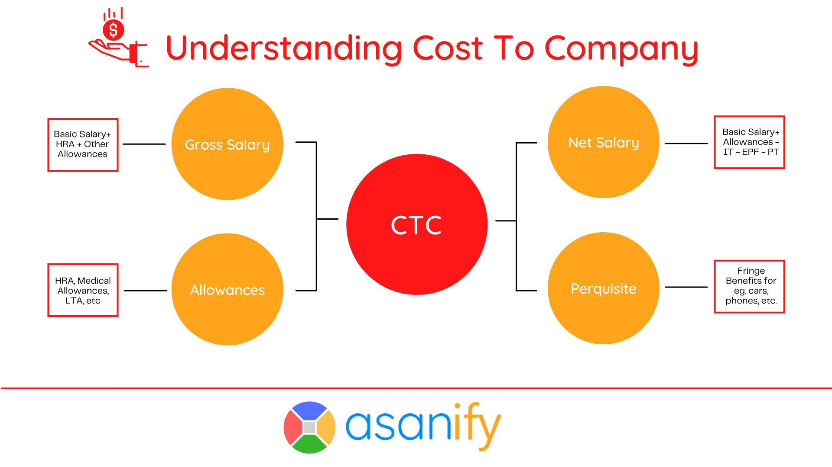
Who are the end users?

Slide 7
Our solution and its value proposition
Conditional formatting – missing
Filter-remove
Formula-performance
Pivot-summary
Graph-data visualization

Slide 8
Dataset description
Employee—kaggle
26 features
9-features
Emp id-num name-text
Emp type performance level gender-male female
Employee rating -num

Slide 9
The “WOW” in our solution
D.A=C2’10%
GROSS SALARY=C2+D2+E2
P.F=F2’8%
NET SALARY=F2-G2

Slide 10
Modelling
1.Data collection
KAGGLE
DASH BOARD DOWNLOAD
2. FEATURE COLLECTION
IDENTY FEATURE
3.DATA CLEANNING
MISSING IDENTIFY
MISSING VALUE FILTER OUT
4.PERFORMANCE LEVEL
CALCULATE
D.A=C2’10%
GROSS SALARY=C2+D2+E2
P.F=F2’8%
NET SALARY=F2-G2
5.SUMMARY
PIVOTABLE
EMPLOYEE NUMBER
GENDER
BASIC SALARY
D.A
GROSS SALARY
P.F
NET SALARY

Slide 11
RESULTS

Slide 12
Conclusion
THE AUTOMAED SALARY SHEET IN EXCEL PROVIDES AN EFFICIENT ACCURATE AND COST EFFECTIVE SOLUTION FOR MANAGING EMPLOYEE PAYROLL.I WILL LEARNED IN SALARY SHEET SUCH AS D.A , GROSS SALARY, INCOME TAX ,P.F AND NET SALARY .

